Slide 1

S D MEMORIAL SR. SEC. SCHOOL
COMPREHENSIVE ACADEMIC PLANNER SESSION : 2026-27
CLASS : X
JOURNEY TO EXCELLENCE
“Learning shapes essential life skills by nurturing curiosity, strengthening ambition and transforming effort into excellence empowering students to think critically ,act responsibly and contribute confidently to an ever- evolving world.”

Slide 2
ACADEMIC ITINERARY
CONTENT | PAGE NO.
THE CORE PURPOSE AND OBJECTIVE | 1
ENRICHMENT OPPORTUNITIES | 2
HOLISTIC DEVELOPMENT FRAMEWORK | 3
HOLISTIC HABITS FOR LEARNER DEVELOPMENT | 4
RECOMMENDED TEXTBOOKS | 5
ANNUAL SYLLABUS
ENGLISH | 6-8
HINDI | 9-11
MATHEMATICS | 11-16
SCIENCE | 16-18
SOCIAL STUDIES | 19-21
ARTIFICIAL INTELLIGENCE | 22-23
ART INTEGRATION | 24-25
COUNSELLING SESSION | 26
ACADEMIC CALENDAR | 27-28
HOLIDAYS LIST | 28

Slide 3

THE CORE PURPOSE AND OBJECTIVE
The Academic Planner is thoughtfully designed in alignment with the National Education Policy (NEP) 2020 and the National Curriculum Framework (NCF) to support meaningful, structured, and future-ready learning.
It serves as a comprehensive guide for academic planning, enabling students and teachers to organize learning goals, classroom activities, assessments, and reflections in a systematic manner. The planner promotes a shift from rote learning to competency-based and experiential learning, encouraging students to understand concepts deeply and apply knowledge in real-life contexts.
A strong emphasis is placed on Subject Enrichment Activities (SEA), Experiential Learning Acquisition (ELA), and Art Integrated Learning (AIL), which are seamlessly integrated into the curriculum to foster hands-on learning, creativity, aesthetic sensibility, critical thinking, and problem-solving skills.
The planner supports flexible teaching-learning practices, digital integration, inclusive education, and holistic development. Through continuous feedback, reflection, and month-wise planning, it aims to nurture confident, responsible, and lifelong learners prepared for academic excellence and future challenges.
1

Slide 4
ENRICHMENT OPPORTUNITIES WITHIN THE CURRICULUM
Learning at our school is designed to extend beyond textbooks and classrooms, offering students enriching experiences that nurture curiosity, creativity, competence, and confidence. The curriculum integrates meaningful opportunities that promote active engagement, practical application, and holistic skill development in alignment with the vision of NEP 2020.
Students are provided with opportunities to develop academic understanding along with essential life skills through:
Project-Based and Inquiry-Based Learning: Inquiry, collaboration, creativity, and presentation through real-world and interdisciplinary tasks.
Experiential and Hands-on Learning: Hands-on activities, experiments, field visits, and practical exposure.
Art Integrated Learning (AIL): Creative expression through visual and performing arts to strengthen concept clarity.
Technology and Digital Integration: Use of digital tools and AI-enabled resources to build digital awareness and skills.
Communication and Language Skills: Focus on speaking, listening, reading, writing, and vocabulary development.
Curricular and Co-curricular Engagement: Building empathy, resilience, teamwork, leadership, and decision-making skills.
Environmental Awareness: Promoting sustainability, conservation, and responsibility towards nature.
Co-curricular Engagement: Participation in clubs, houses, competitions, sports, and community service.
These opportunities ensure holistic, learner-centric development and prepare students to become confident, adaptable, and responsible individuals.
2

Slide 5
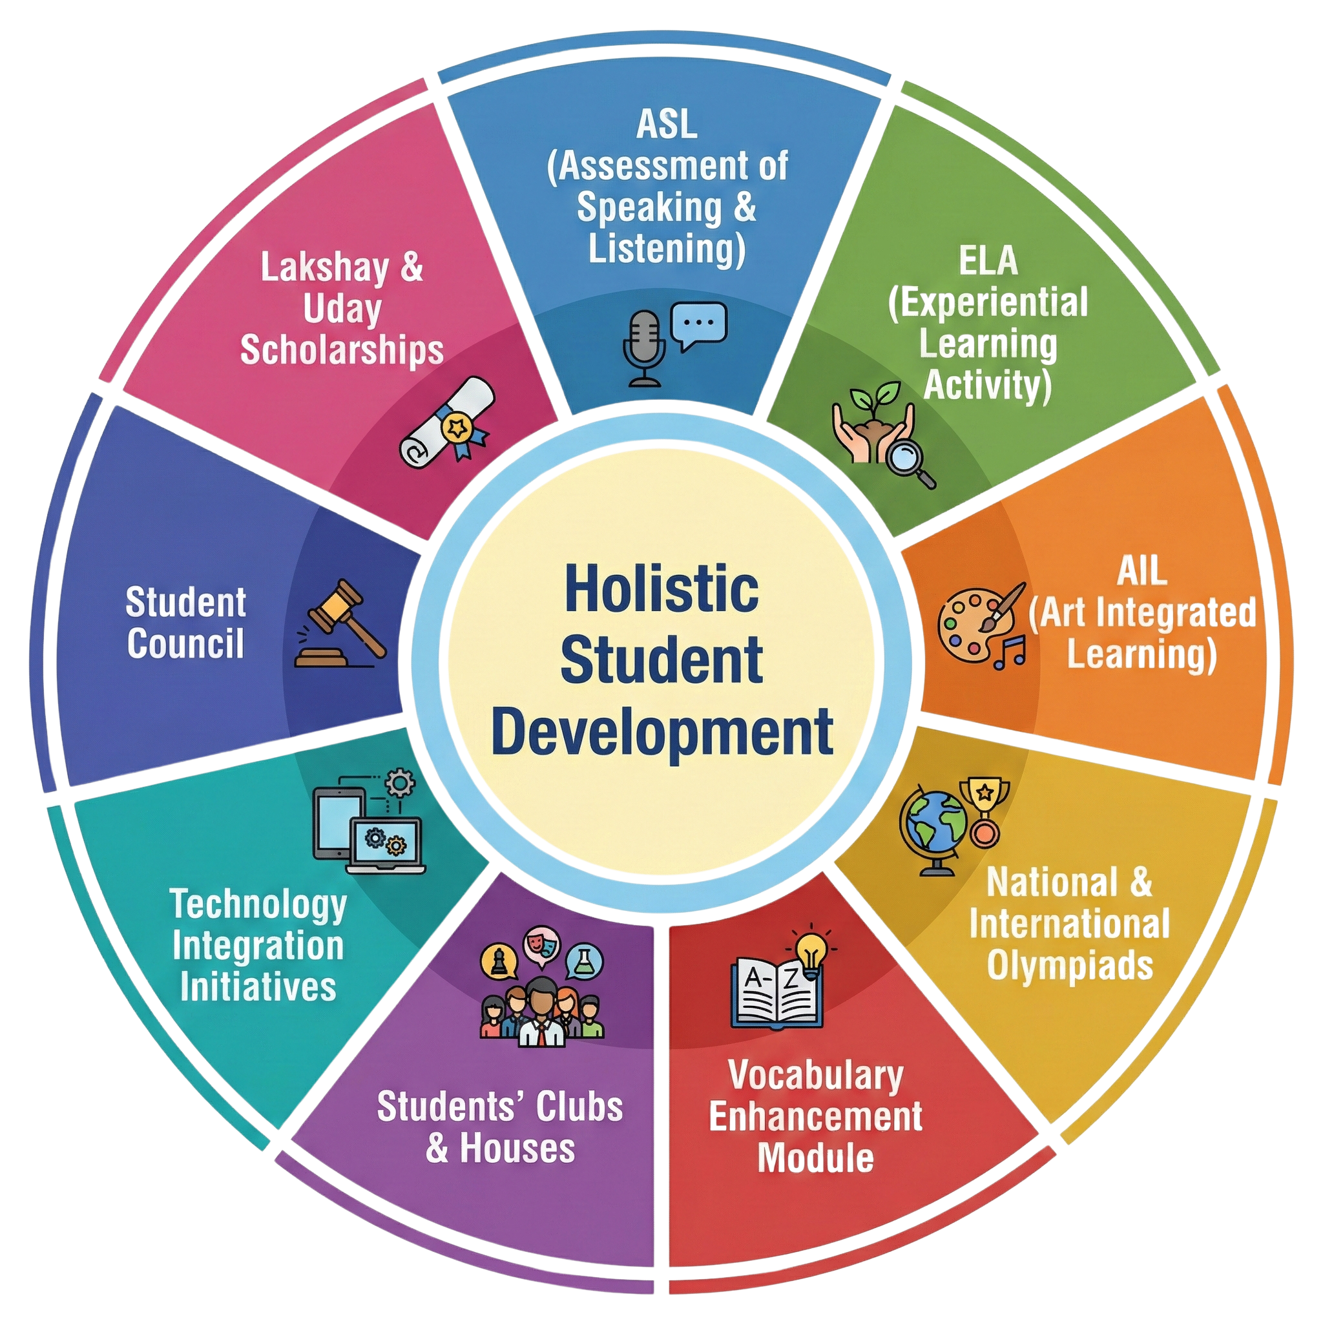
Holistic Development Framework:
Empowering Students Beyond Academics
At SDMS, we are committed to maintaining high standards of excellence by nurturing every dimension of a child’s development. Our student development initiatives are designed to complement academic learning while promoting confidence, competence, and character.
3

Slide 6
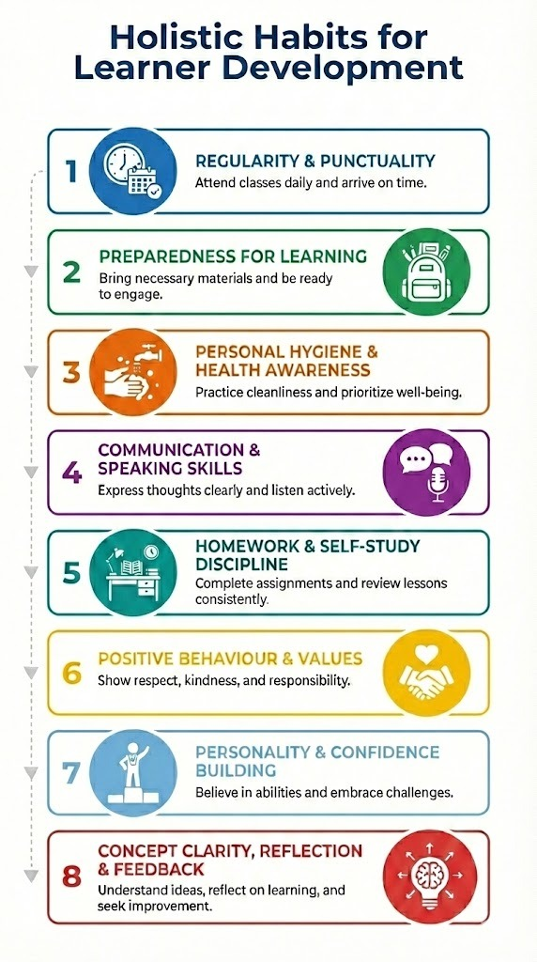
4

Slide 7
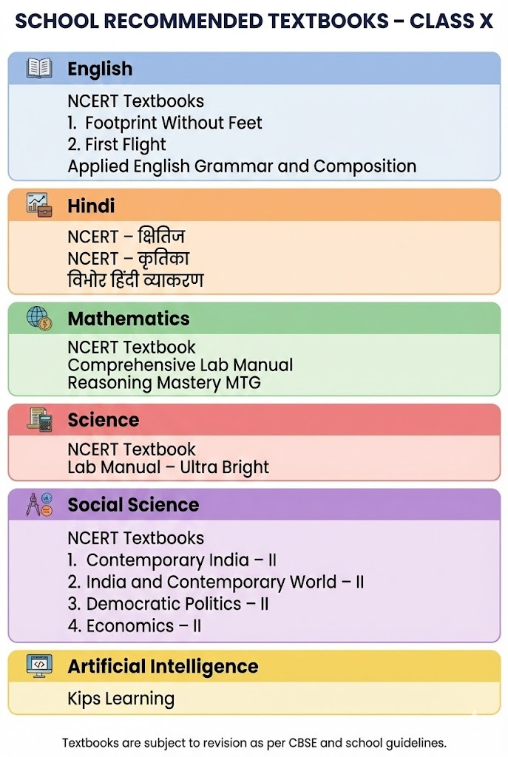
5

Slide 8
MONTH/ SUBJECT | ENGLISH (LANGUAGE AND LITERATURE Subject Code- 184
MARCH | Literature: Prose-1. A Letter To God 2. Nelson Mandela: A Long Walk To Freedom Poetry - 1. Dust of Snow 2. Fire and Ice Supplementary Reader- 1. A Triumph of Surgery 2. A Thief’ Story Grammar: Tenses, Determiners Writing Skills : Letter to Editor SEA/ELA : From Hope to action Students will prepare and present a speech (two min.) on the topic: “How Sustainable farming can help farmers avoid losses”. AIL : Nature’s Small Turning Points : Bookmark Creation Students will design a handmade bookmark using imitation of natural motifs (leaf, snowflake, crow) with a quote or line reflecting emotional changes in the Poem- Dust of Snow. Skills Developed- Speaking Skills , Emotional Intelligence, Artistic Skills
APRIL | Literature: Prose -3.Two Stories About Flying 4. From the Diary of Anne Frank Poetry -3. A Tiger In The Zoo, 4. How to Tell Wild Animals. Supplementary Reader- 3. Mid Night Visitor 4. A Question of Trust Grammar: Subject verb concord Writing Skills : Formal Letter (Complaint) SEA/ELA : Discovering Anne : Voices from the Diaries Each Student will select one prominent character trait of Anne Frank (optimism, courage, honesty, curiosity,sensitivity,resilience) Students will prepare a 2 min reflective monologue as if they are Anne Frank. AIL-“Postcard from the Wild” : Seeing the World through an animal’s Eyes Students will imagine themselves as wild animals living in forests, cages, or zoos. They will design a postcard from the animal’s habitat, visually representing its surroundings on the front and writing a short first-person message to humans on the back. Skills Developed: Speaking Skill, Reflective Thinking, Creative Writing Skill.
6

Slide 9
MAY | Poetry : 5.The Ball Poem, 6.Amanda Supplementary Reader: 5. Footprint Without Feet Grammar: Connectors Writing Skills : Analytical Paragraph SEA/ELA : Personal Reflection Journal Students will recall a time they lost something valuable and will frame 4–5 lines about how it felt and what they learned linking it to the poem’s theme of loss and learning to cope. AIL : “Comic Strip: Invisible Trouble” Students will create a comic strip depicting one episode from the story- Foot Prints Without Feet, using visual clues (floating objects, reactions) to show invisibility instead of drawing Griffin. Skills Developed: Story Telling Skill, Critical Thinking, Artistic Expression. Project- Lexicon Chronicles Students will create a portfolio that highlights language skills through poems, interviews, literature reflections, and expressive visual storytelling.
JULY | Literature: Prose-7. Glimpses of India , 8. Mijbil The Otter Supplementary Reader: 6. The Making of a Scientist Grammar: Direct & Indirect Speech Writing Skills : Letter for placing an order SEA/ELA : Scientist Profile Students will pick a scientist (living or historical) and create a profile card including: name, field, major discoveries, challenges faced, qualities that helped them to succeed (like perseverance, curiosity) and will associate these qualities with Richard Ebright from the lesson-The Making of a Scientist. AIL : “Colours of India” – Cultural Collage Students will create a collage representing the three regions (Goa, Coorg, and Assam) from the lesson Glimpses of India. Through drawings, textures, and symbols (beaches, coffee plantations, tea gardens, rivers), they will visually express India’s cultural and natural diversity. Skills Developed: Comparative Thinking, Critical and Creative Thinking.
AUGUST | Literature: Prose-9. Madam Rides The Bus Supplementary Reader: 7. The Necklace, 8. Bholi Grammar: Active passive voice Writing Skills: Story Writing
7

Slide 10

 | SEA/ELA : Mock Interview with Bholi Students will conduct a mock interview as journalists interviewing Bholi after she stands up to the groom. Skills Developed: Speaking, Emotional Intelligence , Critical Thinking, Role Playing. REVISION FOR FIRST TERM EXAMS
SEPTEMBER | Poetry: 7.The Trees, 8. Fog AIL :Breaking Barriers – Freedom Silhouette Art Students will create black silhouettes of trees, chains, walls, or other obstacles on a bright background to express breaking free, growth, and freedom, inspired by the Poem- The Trees. Skills Developed: Creativity & Critical Thinking
OCTOBER | Literature: Prose-10. Sermon at Benares, 11. The Proposal, Poetry : 9. The Tale of Custard The Dragon , 10. For Anne Gregory Supplementary Reader: 10. The Book that saved the Earth. Grammar : Integrated Grammar Writing Skills: Enquiry Letters SEA/ELA : Connect to Literature Reflecting from the lesson “Sermon at Benares”- Students will find and discuss another story, poem, or incident they’ve read that shows how fear or desire affected someone’s life. AIL :Character in Motion – Freeze Frame Art Students will draw or create paper puppets of the main characters (Lomov, Natalya, and Chubukov) showing their emotions and conflicts during the proposal scene. They can exaggerate expressions to reflect humor and tension. Skills Developed: Visual Storytelling Skill, Artistic Skills, Critical Thinking.
NOVEMBER- FEBRUARY | DOUBT CLASSES, PRACTICE PAPERS & REVISION FOR PREBOARD & BOARD EXAMS
Discussion of MCQ Assignments will be taken parallel to the chapters every month.
8

Slide 11
MONTH/ SUBJECT | हिंदी - पाठ्य पुस्तक कोर्स-A (002)
मार्च | क्षितिज गद्य खंड :पाठ-10 नेताजी का चश्मा पद्य-खंड: कविता-1 उद्धो तुम हो अति बड़भागी व्याकरण : पाठ-1 रचना के आधार पर वाक्य भेद सृजनात्मक लेखन : अनौपचारिक व औपचारिक पत्र लेखन SEA/ELA -कथन / वस्तु-वाचन शीर्षक: जब चश्मा बोल उठा विद्यार्थी कल्पना करेंगे कि नेताजी का चश्मा स्वयं अपनी कहानी सुना रहा है। वे बताएँगे कि उन्होंने बताएगा क्या-क्या देखा, लोगों का बदलता दृष्टिकोण और स्वतंत्रता संग्राम से जुड़ी भावनाएँ कैसी थीं। प्रस्तुति मौखिक वाचन के रूप में होगी। AIL -भक्ति बनाम ज्ञान : प्रेम की श्रेष्ठता विद्यार्थी इस पद में व्यक्त सगुण भक्ति, प्रेम, विरह और ज्ञान-मार्ग के भावों को प्रतीकात्मक कला के माध्यम से प्रस्तुत करेंगे। वे कोलाज बनाकर कमल, हृदय, दीपक, मस्तक पर मुकुट, पुस्तक जैसे प्रतीकों का प्रयोग करेंगे। प्रत्येक प्रतीक के साथ उसका भावात्मक व सामाजिक अर्थ भी संक्षेप में लिखेंगे। अंत में विद्यार्थी यह संदेश देंगे कि ज्ञान से बढ़कर प्रेम और भक्ति मानव जीवन को सार्थक बनाते हैं। कौशल विकसित :कल्पनाशक्ति, रचनात्मक लेखन, भावात्मक अभिव्यक्ति, आत्मचिंतन
अप्रैल | क्षितिज गद्य-खंड: पाठ-11 बालगोबिन भगत कृतिका : पाठ-1 माता का आँचल व्याकरण : पाठ-2 वाच्य सृजनात्मक लेखन : अनुच्छेद व ई -मेल लेखन SEA/ELA : “मूल्य संवाद – आज के समय में बालगोबिन भगत” छात्र समूहों में यह कल्पना करेंगे कि बालगोबिन भगत आज के समाज में हैं। विद्यार्थी उनके जीवन-मूल्यों को वर्तमान जीवन से जोड़ते हुए संवाद / लघु भूमिका-अभिनय प्रस्तुत करेंगे। AIL : “मूल्य-मानचित्र (Value Mind Map)” छात्र बालगोबिन भगत के जीवन से जुड़े प्रमुख मूल्यों—जैसे भक्ति, सादगी, मानवीय संवेदना, सामाजिक समरसता और आत्मानुशासन को पहचानेंगे। इन मूल्यों को Mind Map के रूप प्रस्तुत करेंगे। अंत में विद्यार्थी अपने मानचित्र का संक्षिप्त मौखिक प्रस्तुतीकरण भी देंगे। कौशल विकसित:रचनात्मक अभिव्यक्ति, भावबोध, साहित्यिक समझ, प्रतीकात्मक सोच, आलोचनात्मक चिंतन, नैतिक मूल्यबोध
मई | क्षितिज पद्य-खंड : कविता-5 उत्साह , अट्ट नहीं रही है कृतिका : पाठ-5 मैं क्यों लिखता हूँ? व्याकरण पाठ-3 पद - परिचय सृजनात्मक लेखन: स्ववृत्त व संदेश लेखन SEA/ELA : “डिजिटल दुनिया : सुरक्षित या असुरक्षित? विद्यार्थी साइबर अपराध और इंटरनेट के बढ़ते प्रभाव पर समूहों में चर्चा करेंगे। वाद–विवाद या पोस्टर प्रस्तुति के माध्यम से वे इंटरनेट के सही और जिम्मेदार उपयोग पर अपने विचार व्यक्त करेंगे। छात्र यह भी आत्ममंथन करेंगे कि वे क्या लिखते/साझा करते हैं और क्यों?
9

Slide 12
 | AIL : “शब्दों का शहर”(पद–परिचय आधारित गतिविधि) कक्षा को पाँच समूहों में विभाजित किया जाएगा—संज्ञा नगर, सर्वनाम चौक, क्रिया मार्ग, विशेषण गली और अव्यय पार्क। प्रत्येक समूह अपने निर्धारित पद के अंतर्गत पाँच उपयुक्त शब्द चुनेगा। छात्र उन शब्दों के आधार पर एक छोटा दृश्य, चित्र या पोस्टर तैयार करेंगे। प्रस्तुति के दौरान वे यह स्पष्ट करेंगे कि चुने गए शब्द उसी स्थान के निवासी क्यों हैं ? कौशल विकसित: व्याकरणिक समझ, विश्लेषण क्षमता, भाषा-प्रयोग कौशल, रचनात्मक सोच, सहयोगात्मक अधिगम परियोजना कार्य: साहित्य : बीते कल से आज तक छात्र किसी एक कवि या लेखक का चयन करेंगे उसकी रचनाओं का आज के विषय में उपयोग और भूमिका बताते हुए अपनी परियोजना तैयार करेंगे। शामिल करें: शीर्षक, पोस्टर,नारा, संक्षिप्त विवरण।
जुलाई | क्षितिज गद्य-खंड : पाठ-16 नौबतखाने में इबादत पाठ -14 एक कहानी यह भी पद्य-खंड : कविता-2 राम-लक्ष्मण-परशुराम-संवाद व्याकरण: पाठ-4 अलंकार सृजनात्मक लेखन : विज्ञापन लेखन SEA/ELA : “संवाद की अदालत”(राम–लक्ष्मण–परशुराम संवाद पर आधारित) कक्षा को न्यायालय में परिवर्तित किया जाएगा। विद्यार्थियों को तीन भूमिकाओं—न्यायाधीश, वकील और गवाह—में विभाजित किया जाएगा। विषय होगा: क्या परशुराम का क्रोध उचित था? वकील और गवाह केवल पाठ में दिए गए संवादों के आधार पर अपने तर्क और साक्ष्य प्रस्तुत करेंगे और उसकी तुलना आज के सामाजिक व्यवहार और मूल्यों से करेंगे । AIL: मुखौटा कला एवं भाव-अभिनय विद्यार्थी राम, लक्ष्मण और परशुराम के Paper Masks / Face Art बनाएँगे।प्रत्येक मुखौटे के भाव—क्रोध, विनम्रता, मर्यादा और आत्मसंयम—को रंगों व रेखाओं से दर्शाया जाएगा।इसके बाद मुखौटे पहनकर मौन-अभिनय के माध्यम से संवाद का भाव प्रस्तुत किया जाएगा। कौशल विकसित:रचनात्मक अभिव्यक्ति, भावात्मक समझ, कल्पनाशीलता, सौंदर्यबोध, संप्रेषण कौशल, गैर-मौखिक अभिव्यक्ति, सहयोगात्मक कार्य
अगस्त | क्षितिज पद्य-खंड : कविता-3 यह दंतुरित मुस्कान , फसल, कविता-4 आत्मकथ्य व्याकरण: रचना के आधार पर वाक्य भेद , पद - परिचय(दोहराई ) सृजनात्मक लेखन : स्ववृत्त व ई-मेल लेखन ( दोहराई)
10

Slide 13
 | SEA/ELA : “बीज से फसल तक” विद्यार्थी फसल उत्पादन की सम्पूर्ण प्रक्रिया को समझेंगे तथा किसान के परिश्रम और प्रकृति के सहयोग का महत्व जानेंगे। छात्र बीज, वर्षा, सूर्य, किसान और फसल की भूमिकाएँ निभाएँगे। संकेतों और अभिनय के माध्यम से ‘बीज से फसल तक की यात्रा’ को मंचित किया जाएगा I अर्धवार्षिक परीक्षा के लिए दोहराई
सितंबर | गद्य-खंड : पाठ -12 लखनवी अंदाज़ AIL: लेखन-शैली - लखनवी अंदाज़ : शालीनता का विज्ञापन” विद्यार्थी लखनवी तहज़ीब और शालीन भाषा-शैली से प्रेरित होकर एक रचनात्मक विज्ञापन तैयार करेंगे। वे भाषा की मधुरता, शिष्टाचार और सांस्कृतिक सौंदर्य को आधुनिक मीडिया के संदर्भ में प्रस्तुत करेंगे। कौशल विकसित:रचनात्मक लेखन, भाषा-शैली की समझ, शिष्ट एवं प्रभावी संप्रेषण, सांस्कृतिक बोध, कल्पनाशीलता, सौंदर्यबोध, प्रस्तुति कौशल
अक्टूबर | क्षितिज गद्य-खंड : पाठ-17 संस्कृति कृतिका : पाठ-3 साना - साना हाथ जोड़ि पद्य-खंड : कविता-10 संगतकार व्याकरण : अलंकार, वाच्य (दोहराई) सृजनात्मक लेखन: औपचारिक व अनौपचारिक पत्र (दोहराई) SEA/ELA : “मेरी संस्कृति – मेरी नज़र से” छात्र स्वयं को एक सांस्कृतिक पत्रकार या ट्रैवल व्लॉगर के रूप में दिखाएंगे। वे अपने आसपास के किसी स्थानीय सांस्कृतिक स्थल, परंपरा, लोककला, पर्व या रीति-रिवाज का चयन करेंगे और उस पर Mini Script या Photo Story तैयार करेंगे। AIL: प्रतीकात्मक स्कल्पचर एवं फिंगर आर्ट” विद्यार्थी “साना–साना हाथ” को केंद्र में रखते हुए Clay Art / Paper Sculpture / Finger Art तैयार करेंगे।इन कलाकृतियों में छोटे हाथों के माध्यम से संवेदना, करुणा, मानवीय जुड़ाव और सामाजिक असमानता को प्रतीकों द्वारा दर्शाया जाएगा। कौशल विकसित- रचनात्मक अभिव्यक्ति, प्रतीकात्मक सोच, संवेदनशीलता एवं सहानुभूति, सामाजिक चेतना, कल्पनाशीलता, सूक्ष्म मोटर कौशल, सौंदर्यबोध, सहयोगात्मक कार्य
NOVEMBER- FEBRUARY | DOUBT CLASSES, PRACTICE PAPERS & REVISION FOR PREBOARD & BOARD EXAMS
Discussion of MCQ Assignments will be taken parallel to the chapters every month.
11

Slide 14
MONTH/ SUBJECT | MATHEMATICS Subject Code-041
MARCH | Ch-1 Real Numbers, Ch-2 Polynomials SEA/ELA: Polynomial Story Builder Students will create short real-life stories (profit–loss, area, speed) and represent them using polynomial expressions, followed by peer discussion. AIL: Math Word Challenge– Real Numbers Edition Students will participate in an engaging math word-guessing activity based on key concepts such as Real Numbers, Prime Numbers, HCF–LCM, and the Fundamental Theorem of Arithmetic. With each incorrect guess, they will draw a part of a figure, making the activity interactive and drawing-based. After identifying the correct word, students will strengthen their understanding by giving examples, creating factor trees, and presenting concepts through small sketches or flow charts. Skills Developed: Number System Understanding, Problem-Solving , Logical Reasoning
APRIL | Ch-7 Coordinate Geometry Ch-8 Introduction to Trigonometry including T-Identities Ch-9 Applications of Trigonometry SEA/ELA: Shadow & Height Exploration Students will experimentally determine the height of nearby objects using shadows, angles, and trigonometric ratios. AIL: Coordinate Rangoli Students will create a rangoli design on graph paper by plotting coordinates and joining points to form artistic patterns. Skills Developed: Measurement Skills ,Graphical Understanding, Real Life Application
MAY | Ch-3 Pair of Linear Equations in Two Variables Ch-5 Arithmetic Progressions Ch-14 Probability SEA/ELA : Chance & Choice Studio Students will conduct real-life probability experiments using spinners, cards, and dice and compare theoretical and experimental results. AIL: AP Life Comic Strip Students will design a comic strip showing a real-life AP situations (salary increase, stair steps, savings growth), with each frame as one term. Skills Developed: Real-Life Problem Solving , Experimental Learning, Group Collaboration
12

Slide 15
JULY | Ch-10 Circles Ch-13 Statistics SEA/ELA : Data Speaks Project Students will collect, organize, and interpret real data through graphical and statistical measures to draw meaningful conclusions. AIL: Mandala of Circles Students will create mandala using only circles, tangents, and chords, labelling mathematical parts. Skills Developed: Data Handling, Artistic Expression
AUGUST | Ch-4 Quadratic Equations SEA/ELA : Quadratic Decision Maker Students will solve quadratic equations arising from real-life decision-making situations (projectile motion, profit models). Skills Developed: Proof skills, Conceptual Clarity, Reasoning Ability REVISION FOR FIRST TERM EXAMS
SEPTEMBER | Ch-6 Triangles AIL: Maths Fashion – Triangle Wearables Students will design paper crowns, badges, or wearables using triangular patterns labelled with properties. Skills Developed: Proof Skills, Conceptual Clarity
OCTOBER | Ch-11 Area Related to Circles Ch-12 Surface Areas And Volumes SEA/ELA : Math in My Bag Students will analyze everyday objects (bottles, boxes, cans) to calculate surface area and volume. AIL: Design a Smart Park Students will design a circular park layout and calculate areas, paths, and boundaries using circle concepts. Skills Developed: Visualization , Real Life Application, Measurement & Estimation
NOVEMBER - FEBRUARY | DOUBT CLASSES, PRACTICE PAPERS & REVISION FOR PREBOARD & BOARD EXAMS
Discussion of MCQ Assignments will be taken parallel to the chapters every month.
13

Slide 16
MONTH/ SUBJECT | ACTIVITIES TO BE CONDUCTED IN MATHS LAB
MARCH | To experimentally find the HCF of two numbers. Project- 2. Geometry in Daily Life 3. Displacement and Rotation of a Geometrical Figure
APRIL | 4.To find the height of a building using a clinometer. 5.To verify the distance formula by graphical method. 6.To verify section formula by graphical method. Project- 7.Efficiency in Packing
MAY | 8.To verify the conditions for consistency/inconsistency for a pair of linear equations in two variables by graphical method. 9.To identify arithmetic progressions in some given lists of numbers 10.To establish a formula for the sum of first n terms of an arithmetic progression. 11.To determine experimental probability of 1, 2, 3, 4, 5 or 6 by throwing a dice 500 times and compare them with their theoretical probabilities. 12.To determine experimental probability of a Head (or a Tail) by tossing a coin 1000 times and compare it with its theoretical probability.
JULY | 13.To verify experimentally that the tangent at any point to a circle is perpendicular to the radius through the point. 14.To find the number of tangents from a point to a circle. 15.To verify that lengths of tangents to a circle from some external point are equal. Project- 16.Golden Rectangle and Golden Ratio
AUGUST | 17.To verify Pythagoras Theorem. 18.To illustrate that the medians of a triangle concur at a point called the centroid, which always lies inside the triangle, using paper folding method.
SEPTEMBER | 19.To draw a system of similar triangles, using Y-shaped strips and nails. 20.To verify Basic Proportionality Theorem (Thales’ Theorem). 21.To establish the criteria for similarity of two triangles. 22.To find the relationship between areas and sides of similar triangles.
14

Slide 17

OCTOBER | 23.To obtain formula for area of a circle experimentally. 24.To obtain formula for the surface area of a circus tent. 25.To verify the formula for the volume of a cylinder. 26.To compare two cylinders made from rectangular sheets of same dimensions under the following aspects: (a) Curved surface areas (b) Total surface areas(c) Volumes
MONTH/ SUBJECT | REASONING WORKBOOK (EVERY FRIDAY)
MARCH | Ch-1 Series Completion (Verbal) Ch-2 Analogy (Verbal) Ch-3 Classification (Verbal) Ch-4 Coding- Decoding (Verbal)
APRIL | Ch-5 Blood Relation (Verbal) Ch-6 Puzzle Test (Verbal) Ch-7 Sequential Output Tracing (Verbal) Ch-8 Direction Sense Test (Verbal)
MAY | Ch-9 Logical Venn diagrams (Verbal) Ch-10 Alphabet test (Verbal) Ch-11 Alpha- Numeric, Numbers (Verbal) Ch-12 Mathematical Operations ( Verbal)
JULY | Ch-13 Inserting the Missing Character ( Verbal) Ch-14 Series Completion (Non Verbal) Ch-15 Analogy and Classification (Non Verbal) Ch-16 Analytical Reasoning (Non Verbal)
15

Slide 18
AUGUST | Ch-17 Mirror and Water Images (Non Verbal) Ch-18 Spotting out the Embedded.. Non Verbal)
SEPTEMBER | Ch-19 Figure Matrix (Non Verbal) Ch-20 Paper folding & Paper Cutting (Non Verbal) Ch-21 Grouping of identical figures (Non Verbal)
OCTOBER | Ch-22 Cubes and dice (Non Verbal) Ch-23 Dot Situation (Non Verbal) Ch-24 Constructing of Squares & Triangles (Non Verbal) Ch-25 Figure Formation and Analysis (Non Verbal)
MONTH/ SUBJECT | SCIENCE Subject Code- 086
MARCH | Ch-10 Light, Ch-11 Human Eye & Colorful World SEA/ELA : Light on Trail: Exploring the Laws of Light Students will understand and explore the properties of light (reflection, refraction, dispersion, and formation of images) in a fun, interactive courtroom-style debate. AIL : Spectrum Puzzle Wall – VIBGYOR Students will work in groups, with each group assigned one colour of VIBGYOR to design and present its wavelength range, deviation, and real-life applications. Together, they will assemble a collaborative spectrum wall that will visually demonstrate dispersion and the properties of light. Skills Developed: Scientific Communication, Analytical Skill
APRIL | Ch-1 Chemical Reaction & Equation, Ch-6 Life Processes Ch-14 Our Environment SEA/ELA : : The Biology of Being Me Students will investigate how a specific body system responds and functions during everyday situations. Students will observe and record how their chosen system works in real life, noting changes, patterns, or responses. AIL : Nature’s Power Grid Students will create a creative food web model designed like a metro map, where organisms are shown as “stations” and arrows represent the flow of energy. Multiple interconnected routes will illustrate food chains, helping students visually understand ecosystem balance. Skills Developed: Analytical & Logical Thinking, Creativity
16

Slide 19
MAY | Ch-12 Electricity, Ch-2 Acids, Bases &Salts SEA/ELA :The Salt Voyage Students will create a passport-style booklet for different salts, including the name, chemical formula, method of preparation with balanced chemical equation, physical and chemical properties, uses in daily life, and safety precautions. AIL : Glow in dark - Circuit Chart Students will create a circuit diagram chart using glow-in-the- dark materials to represent electrical circuits. Skills Developed: Scientific communication, Creativity and Innovation
JULY | Ch-3 Metals and Non metals,Ch-4 Carbon and Its Compounds SEA/ELA :Electron Exchange Studio Students will use colored beads or paper cut-outs to model atoms of metals and non-metals and demonstrate the transfer of electrons from one atom to another. Through this hands-on simulation, they will show the formation of positively and negatively charged ions and the electrostatic attraction that results in an ionic bond. AIL : Molecule Makers: Carbon Edition Students will construct 3D models of carbon chains to understand the concept of catenation in carbon. Skills Developed: Spatial and 3D Visualization Skills, Analytical Skills
AUGUST | Ch-13 Magnetic Effect of Electric Current SEA/ELA : Magnetic Harmony Students will create magnetic field patterns around a current- carrying conductor using iron filings or coloured sand on a chart or tray. Skills Developed: Scientific Concept, Observation REVISION FOR FIRST TERM EXAMS
SEPTEMBER | Ch-7 Control and Coordination AIL :Brain Wave Bulletin Students in groups will design a science newsletter featuring reflex action and coordination. Skills Developed: Cognitive & Thinking Skills
17

Slide 20
OCTOBER | Ch-8 How do Organisms Reproduce, Ch-9 Heredity SEA/ELA : Ancestral Traits Students will observe inherited traits in themselves, family members and record them using a Puneet Square, writing a short feed line for each trait. They will analyze patterns, link traits to heredity concepts. AIL : “Life Continuum Art” Students will create a circular artwork representing different stages of human life, highlighting reproductive maturity as a natural part of growth and continuity. Skills Developed: Observation and Analytical Skills, Social and Health Awareness
NOVEMBER- FEBRUARY | DOUBT CLASSES, PRACTICE PAPERS & REVISION FOR PREBOARD & BOARD EXAMS
Discussion of MCQ Assignments will be taken parallel to the chapters every month.
MONTH/ SUBJECT | EXPERIMENTS TO BE CONDUCTED IN SCIENCE LAB
MARCH | 1.To find out the focal length of convex mirror and lens. 2. To study the refraction through glass slab. 3. Tracing the path of the rays of light through a glass prism.
APRIL | 4. To prepare a mount of leaf peel to show stomata. 5.To perform and observe various chemical reaction.
MAY | 6. To find pH of various samples by using pH paper. 7. To study the properties of NaOH & HCl. 8. To verify the Ohm’s Law.
JULY | 9.To observe the action of Zn , Fe , Cu and Al on various salt solutions and to arrange them in the reactivity series.
AUGUST | 10.To study the properties of acetic acid.
OCTOBER | 11. To study Binary Fission in amoeba and Budding in yeast. 12. To identify the various parts of embryo of a dicot seed.
18

Slide 21
MONTH/ SUBJECT | SOCIAL SCIENCE Subject Code- 087
MARCH | Geography :Ch-1 Resources and Development Civics: Ch-1 Power Sharing Economics: Ch-1 Development SEA/ELA : My Growth Graph Students will collect real-life data of their own development based on four indicators – Health (BMI), Study Hours, Family Income Pattern and Digital Access. They will calculate their Personal Development Index (PDI), prepare a bar graph, compare it with India’s HDI, and identify development gaps. AIL : Soil Smart – Our Life Line Students will analyze the importance of soil, identify major soil types of India, understand causes of soil degradation, and suggest conservation measures through a poster and slogan. Skills Developed: Analytical Skills, Decision Making SPS SLOT: To identify and mark the major Soil types found in different regions of India.
APRIL | History: Ch-1 The Rise of Nationalism In Europe Civics: Ch-2 Federalism Economics: Ch-2 Sectors of the Indian Economy Geography: Ch-7 Life Lines of National Economy (Map Only) SEA/ELA : Flow Of Freedom – Unification Trails of Europe Students will prepare a flowchart showing the unification process of European countries — Germany, Italy and Britain. They will design step-by-step visual flowcharts highlighting important events, leaders and treaties, and then present in class. AIL : Public Money Pathway-From Tax to Welfare Students create a Comic Strip showing how tax revenue is collected, allocated, and reaches citizens through welfare schemes. Skills Developed: Decision-Making, Data Interpretation SPS SLOT : To identify and label the major seaports and airports of India
19

Slide 22
MAY | History :Ch-2 Nationalism In India Geography : Ch-2 Forest and Wildlife Resource Ch-3 Water Resources SEA/ELA : Steps to Swaraj – India’s Freedom Timeline Students will create a visual timeline chart showing the major milestones of the Indian National Movement from 1885 to1947. They will arrange events in chronological order, mark important leaders, movements and acts, and explain how nationalism gradually developed in India. AIL: River Parliament – Dam Decisions Students will work in groups to create and perform a rap highlighting the advantages and disadvantages of dams, using simple lyrics and actions to show benefits like irrigation and electricity and problems like displacement and environmental damage. Skills Developed: Historical Analysis, Collaboration & Communication. SPS SLOT: 1. To locate and label the places associated with major events of Indian National Movement and Congress sessions. 2 To identify and label the major dams and reservoirs of India. Project Work: Consumer Awareness OR Social Issues OR Sustainable Development
JULY | Geography: Ch-4 Agriculture History :Ch-5 Print Culture and the Modern World Civics: Ch-3 Gender, Religion, and Caste Economics :Ch-3 Money and Credit SEA/ELA : Be the Banker –Loan and Flow Students will organise an interactive classroom session where they will act as bankers and borrowers to understand the flow of money, the process of lending, and the impact of credit on the economy. AIL : Printed Voices – The Power Of The Press Students will create a miniature inspired by the print culture of the 19th–20th century. They will select a theme such as social reform, women education etc. Skills Developed: Rational Thinking, Analytical Skills SPS SLOT: 1. To identify and mark the major crop-producing regions in India. 2. To locate & label the places known for rice, wheat, and sugarcane cultivation.
20

Slide 23
AUGUST | Civics : Ch-4 Political Parties Geography :Ch-5 Minerals and Energy Resources SEA/ELA : Mock Parliament: Check and Balance Students simulate a parliament session to show how opposition parties hold the government accountable. Skills Developed: Decision making, Political Awareness SPS SLOT: 1. To mark and label the major mineral resources of India. 2. To identify and label the regions with significant coal, iron, and petroleum reserves. 3. To locate and mark the major thermal & Nuclear power plants in India. REVISION FOR FIRST TERM EXAMS
SEPTEMBER | Economics :Ch-4 Globalization and the Indian Economy AIL : Globalisation Impact Map Students, in groups of six, will create and explain a visual impact map highlighting how globalization influences India’s economy, culture, employment, and daily life using textbook and real-world examples. Skills Developed: Collaboration & Communication.
OCTOBER | History :Ch-3 The Making of a Global World Geography: Ch-6 Manufacturing Industries Civics : Ch-5 Outcomes of Democracy SEA/ELA : Globalization in My Daily Life Students will list the global brands/products used daily and trace their origins. AIL : From Raw to Ready-The Industry dance Students will perform a creative dance sequence showing the journey of raw materials to finished goods in manufacturing industries, using body movements to represent machines, factories, and products. A short narration connects each stage to explain how industries support employment and economic growth. Skills Developed: Critical Thinking, Decision Making SPS SLOT: To identify and label the major cotton textile mills, iron and steel plants and software technology parks in India
NOVEMBER- FEBRUARY | DOUBT CLASSES, PRACTICE PAPERS & REVISION FOR PREBOARD & BOARD EXAMS
Discussion of MCQ Assignments will be taken parallel to the chapters every month.
21

Slide 24
MONTH/ SUBJECT | ARTIFICIAL INTELLIGENCE Subject Code- 417
MARCH | PART- B SUBJECT SPECIFIC SKILLS Unit-I Revisiting AI Project Cycle & Ethical Frameworks for AI SEA/ELA : "AI Ethics Debate" Students will take part in a structured group discussion on AI ethics, focusing on data privacy, bias, and the impact of AI on jobs to develop and communication skills. AIL- AI Project Cycle along with Ethical Frameworks Students connect technology with values, understand that AI must be ethical, and learn that art can simplify complex technical ideas. Skills Developed- Communication Skill, Critical Thinking Practical: Area of Rectangle, Triangle & square Students will take input from user and by using of mathematical function they will find the cube of the number and add all.
APRIL | PART- B SUBJECT SPECIFIC SKILLS Unit- II Advanced Concepts of Modeling in AI PART- A EMPLOYABILITY SKILLS Unit-I Communication Skill-II AIL- Expressive skills Students will understand the importance of verbal, non verbal, and visual communication by expressing messages through art forms. Skills Developed- Communication Skill, Creative Thinking, Observation Skill. Practical: Input two numbers and display LCM of two numbers Students will takes two integers num1 and num2 as input and returns their LCM. It starts by finding the maximum of the two numbers, then initializes the LCM as the greater number.
MAY | PART- A EMPLOYABILITY SKILLS Unit-II Self- Management Skill-II Unit- III ICT Skill-II SEA/ELA : Data Collection & Visualization Students will collect classroom data such as favorite subjects or attendance and represent it using appropriate graphs to understand patterns. AIL-Independent Working Ability Students will create a poster or drawing using symbols and colours to depict one self-management skill and briefly explain how it helps in their daily student life. Skills Developed -Time Management, Creativity, Decision-Making
22

Slide 25
JULY | Unit-III Evaluating Models (Part-B) Unit-IV Self management-II (Part-A) SEA/ELA : "AI Bias Investigation" Task: Research bias in AI models (e.g., facial recognition errors) and present findings. Practical: Rock, Paper, Scissor Program allows the user to play Rock, Paper, Scissors against the computer. The user and the computer each choose one of the three options (rock, paper, or scissors), and the program determines the winner based on the classic rules of the game.
AUGUST | Unit- V Computer Vision (Part-B) Unit-V Green Skills-II (Part-A) SEA/ELA : "Speech-to-Text AI" Students will use speech recognition tools such as the Google Speech API to convert spoken language into text and evaluate the accuracy of the output. AIL-Vision-Based Computing Students will create a drawing/poster showing how computers “see” and recognize images (face recognition, traffic signs, object detection) and will explain the process using simple visuals and labels. Skills developed- Digital Literacy, Analytical Thinking, Creativity, Observation Skills Practical: Password Strength Checker Students will evaluates the strength of a password based on certain criteria such as length, presence of uppercase letters, lowercase letters, digits, and special characters.
SEPTEMBER | REVISION FOR FIRST TERM EXAMS
OCTOBER | Unit- VI Natural Language Processing Unit- VII Advanced Python SEA/ELA :"Build an AI-Based Quiz App" Students will design and develop a simple AI-powered quiz application that generates questions based on user input, fostering problem-solving and computational thinking skills.. Practical: Canva Posters
NOVEMBER- FEBRUARY | DOUBT CLASSES, PRACTICE PAPERS & REVISION FOR PREBOARD & BOARD EXAMS
Discussion of MCQ Assignments will be taken parallel to the chapters every month.
23

Slide 26
EK BHARAT SHRESHTHA BHARAT INITIATIVE ART INTEGRATION SESSION : 2026-27 STATE INTEGRATION-HARYANA : MANIPUR
SUBJECT | TOPIC
ENGLISH | Roots of the Hills Students journey into the heart of Manipur through stories and voices of its people. They will read, write, and perform short narratives, monologues, or skits inspired by Manipuri folklore, tribal life, and community traditions. Emphasis will be laid on character portrayal, dialogue writing, values of harmony, and respect for nature. Integration: Literature, Drama, Life SkillsOutcome: Enhanced creative writing, empathy, and spoken English skills.
HINDI | Lok Sanskriti ki Abhivyakt छात्र मणिपुर की लोक-संस्कृति, पर्व-त्योहार, वेशभूषा एवं जीवन-शैली पर कविता, अनुच्छेद अथवा संवाद लेखन करेंगे। भाव-अभिव्यक्ति के साथ-साथ राष्ट्रीय एकता और सांस्कृतिक विविधता को रचनात्मक रूप में प्रस्तुत किया जाएगा। समन्वय: भाषा, संस्कृति, अभिव्यक्ति परिणाम: भाषा-दक्षता, कल्पनाशक्ति और सांस्कृतिक समझ का विकास।
MATHEMATICS | Patterns Woven in Tradition Learners will discover mathematics hidden in Manipuri textiles, handicrafts, and architectural designs. They will identify symmetry, geometric patterns, ratios, and tessellations used in traditional weaving and artwork, and recreate them mathematically. Integration: Geometry, Art Outcome: Logical reasoning, visualisation, and real-life application of mathematics..
24

Slide 27

SCIENCE | Nature’s Balance in Manipur Students will study Manipur’s rich biodiversity, endemic species, and eco-friendly lifestyles of tribal communities. Topics such as sustainable agriculture, medicinal plants, and conservation practices will be linked with scientific concepts. Integration: Biology, Environmental Science Outcome : Environmental awareness, scientific inquiry, and sustainable thinking.
SOCIAL SCIENCE | Manipur: Land, Life & Legacy Students will explore Manipur’s geography, history, tribal communities, and cultural heritage through research-based projects. Using maps, charts, and timelines, they will connect physical features with cultural practices and historical developments. Integration: Geography, History, Civics Outcome: Research skills, analytical thinking, and appreciation of regional diversity.
ARTIFICIAL INTELLIGENCE | Digital Manipur Using digital tools, students will design posters, presentations, or short videos showcasing Manipur’s culture, festivals, crafts, and natural beauty. AI tools may be used for creative design, storytelling, or cultural data presentation. Integration: Technology, Creativity Outcome: Digital literacy, innovation, and responsible use of technology.
25

Slide 28
COUNSELLING SESSIONS FOR THE STUDENTS
MONTH | TOPIC
APRIL | Study smart - Improving study skills Guiding students to adopt smart study habits, understand learning styles and build confidence through planned and effective learning.
MAY | Life skills and personal development Supporting students in enhancing self awareness, emotional intelligence, interpersonal skills and resilience for personal growth.
JULY | Building Positive Habits Helping students to understand the importance of daily routine, self discipline and habit formation for long term success.
AUGUST | Goal Setting and Time Management Focusing on high priority task and adopt practical strategies for better time use and task completion.
SEPTEMBER | Mental health & well-being Supporting students in developing emotional balance, coping skills and a positive mindset for healthy mental well- being.
OCTOBER | Therapy for self -The purpose of our life is to be happy Guiding students to explore their thoughts, emotions and values to develop inner happiness, self acceptance and mental well- being.
NOVEMBER | Self-Care & Wellness Healthy sleeping habits, nutrition, and establishing balance in life.
DECEMBER | Emotional Struggle Resolution Constructive strategies for resolving difference of opinions, focusing on building empathy and finding collaborative solutions.
JANUARY | Digital Wellness Dealing with social media pressure and managing excessive screen time.
26

Slide 29
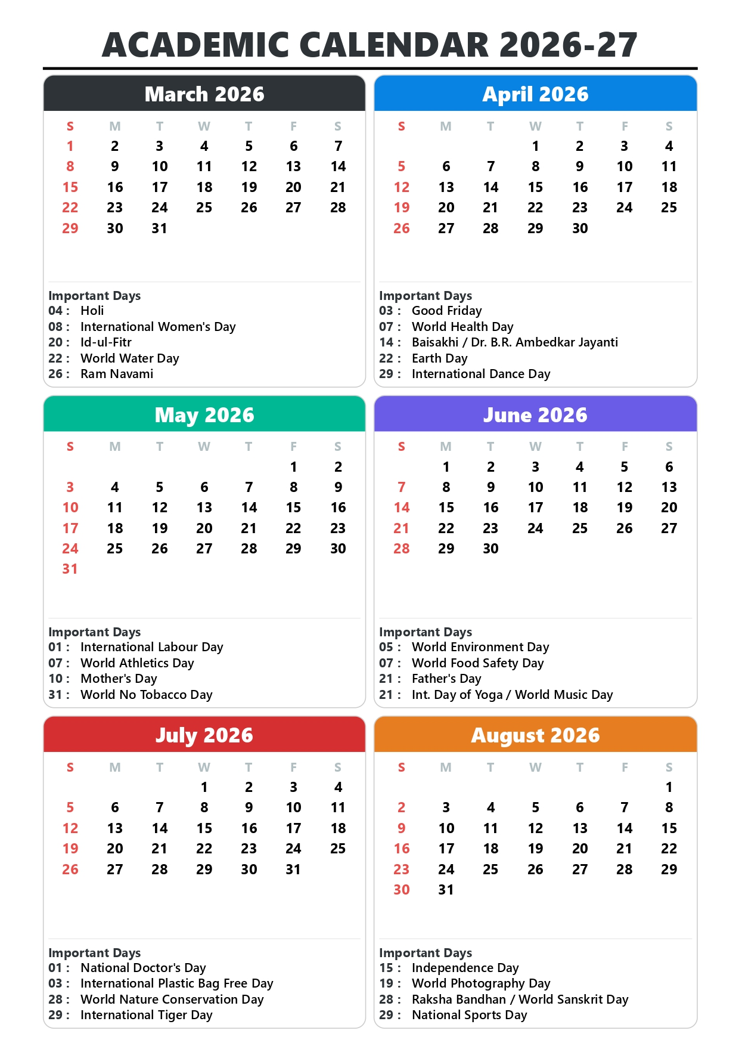
27

Slide 30
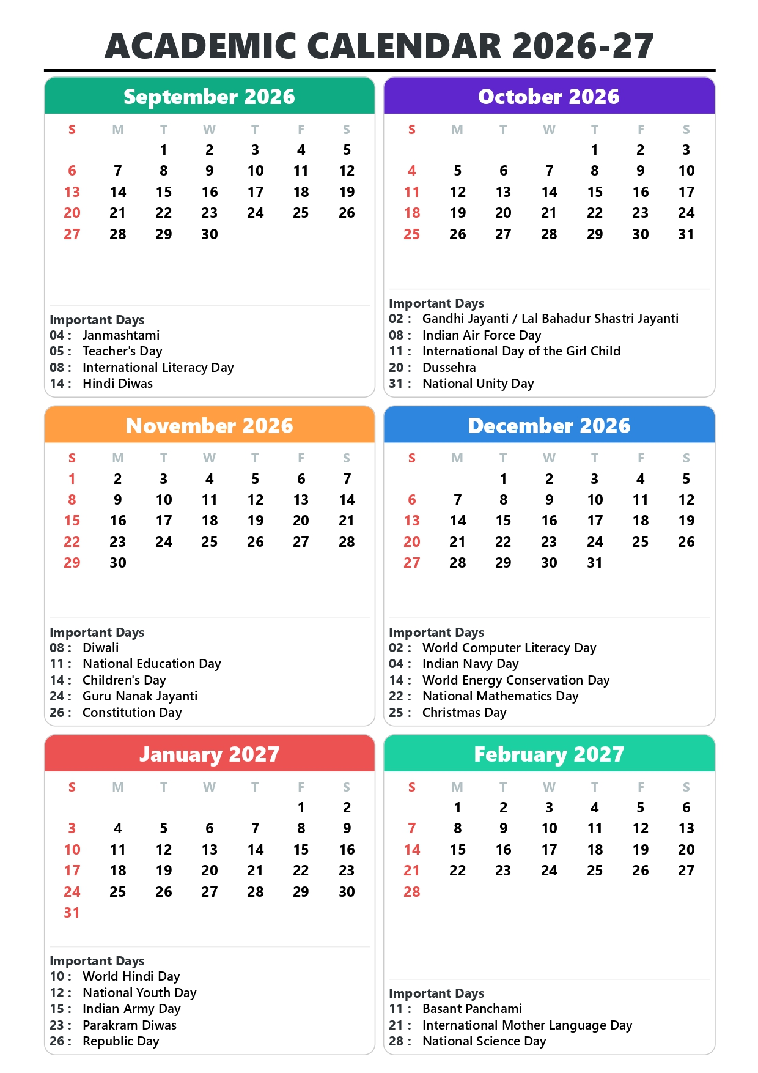
28

Slide 31
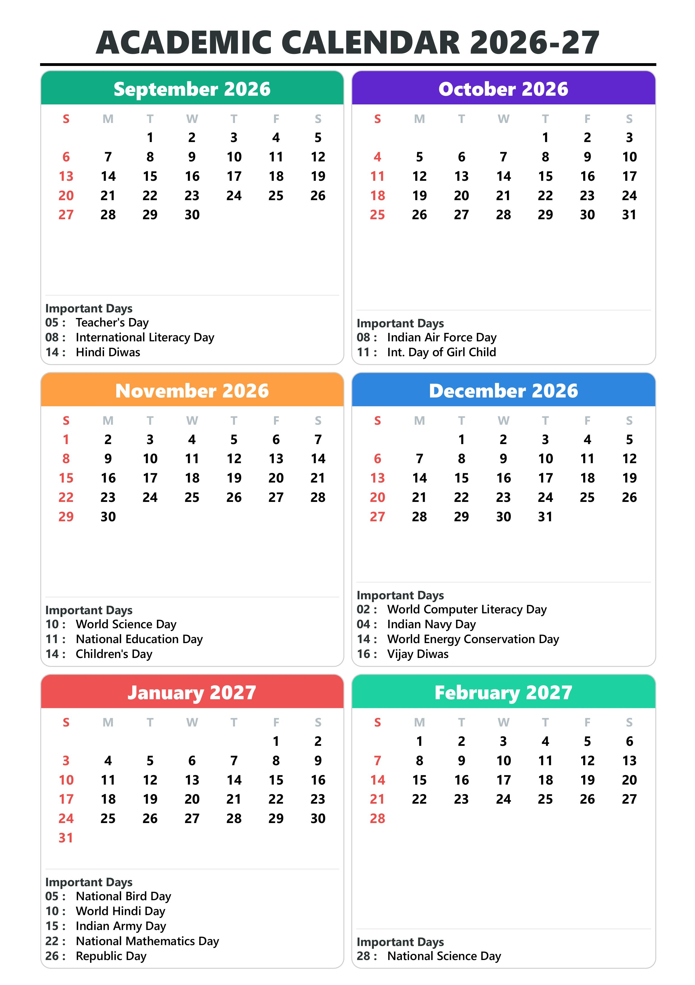
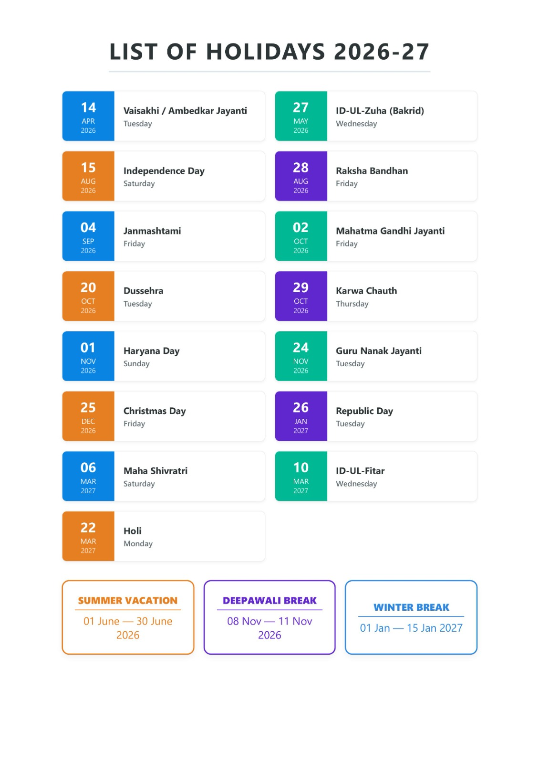
29

Slide 32


